Slide 1
Mango Fruit Disease Detection Using CNN
Antony Nishio J (URK21CS1182)
Guided by: Mr Matthew Palmer

Slide 2
Table of Contents
Introduction
Literature Survey
Methodology
Result
Conclusion
Future Scope
Outcome

Slide 3
Introduction:
Employs Convolutional Neural Networks (CNNs) automate mango fruit disease detection, replacing traditional manual classification methods.
By training datasets, including healthy and diseased mango fruit images, the model enables accurate identification of common diseases like Stem end rot, Alternaria and Anthracnose.
optimized crop management and sustainable agriculture.
The model's accuracy of 96.76% highlights its proficiency in detecting mango fruit diseases, ensuring reliable identification and enabling effective agricultural management.

Slide 4
Literature Survey
Author & Year | Paper | Method | Accuracy
Malathy et al., 2021 | Disease detection in Orange fruit using image processing | MobileNet architecture of CNN | 90.34
Khan et al., 2020 | A Deep Neural Network based disease detection scheme for Citrus fruits | InceptionV3 | 81.7
Ahmad et al., 2020 | Disease detection in plum using convolutional neural network under true field conditions | VGG-VD-16 and CaffeAlexNet, classification with CNN | 89.52

Slide 5
Literature Survey:
Author & Year | Paper | Method | Accuracy
Assunçao et al., 2020 | Decision-making support system for fruit diseases classification using Deep Learning | DenseNet-201 | 81.33
Nasir et al., 2021 | Deep learning-based classification of Banana fruit diseases: An application for precision agriculture | Support Vector Machines (SVM) | 80
Naranjo-Torres et al., 2020 | A review of convolutional neural network applied to fruit image processing | VGG-19 | 92.33

Slide 6
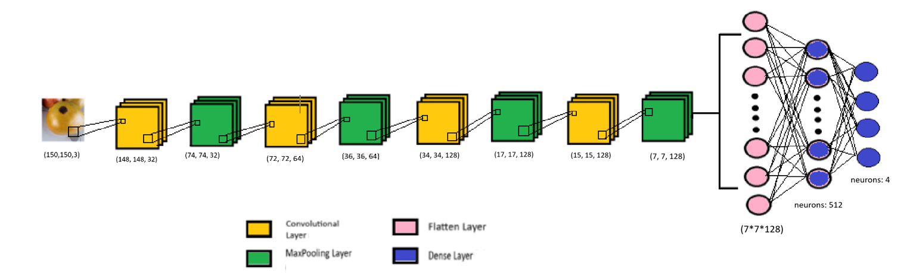
Methodology – CNN Architecture Diagram

Slide 7
Methodology:
1. Data Pre-processing
- Normalization
- Data Augmentation
2. Model Architecture:
- Convolutional Neural Network (CNN
- Flatten and Dense Layers
3. Model Training:
- Compile Model
- Fit Model
4. Model Evaluation:
- Evaluate Model
- Visualization

Slide 8
Implementation
Data Augmentation
Rotation: 40 degrees.
Shift: 20% .
Shear and Zoom: 20% to simulate different perspectives.
Flipping: Horizontally and vertically .
Normalization: Scale pixel values to the range [0, 1] .

Slide 9
Implementation
Convolutional Neural Network (CNN):
Definition: CNN is a type of deep neural network that is primarily used for image analysis and recognition tasks.
Architecture: CNNs consist of convolutional layers, pooling layers, and fully connected layers.
Convolutional Layers: These layers apply filters to input images to extract features like edges, textures, and shapes.
Pooling Layers: Pooling layers reduce the spatial dimensions of the convolved feature maps.
Fully Connected Layers: These layers connect every neuron in one layer to every neuron in the next layer.
Activation Functions: Common activation functions used in CNNs include ReLU (Rectified Linear Unit) and Sigmoid.

Slide 10
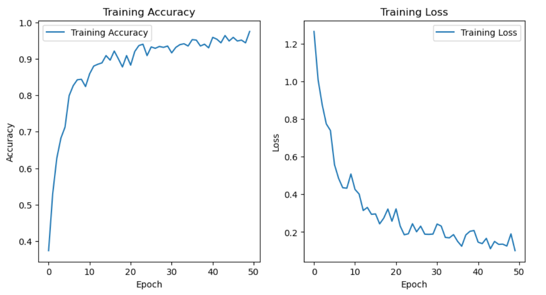
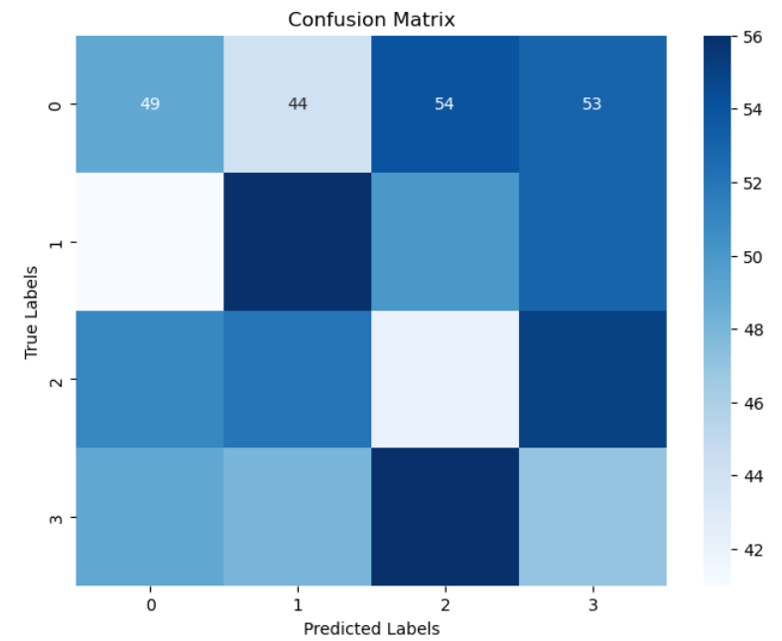
Results

Slide 11
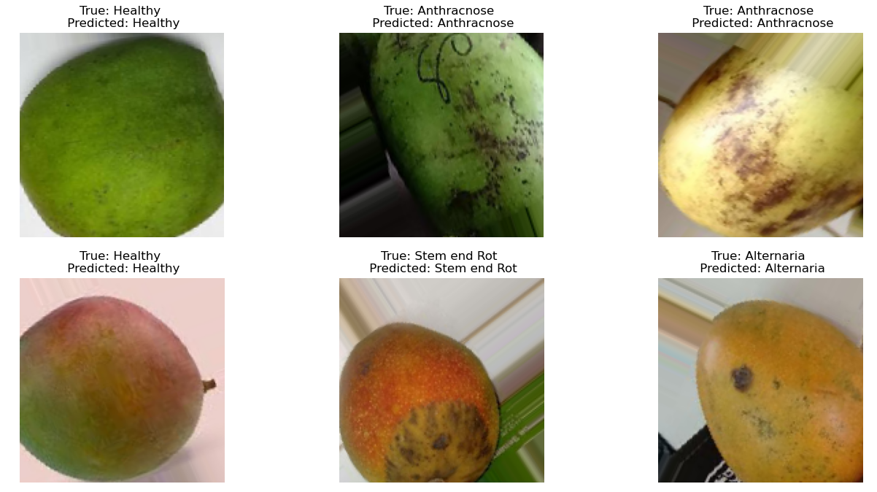
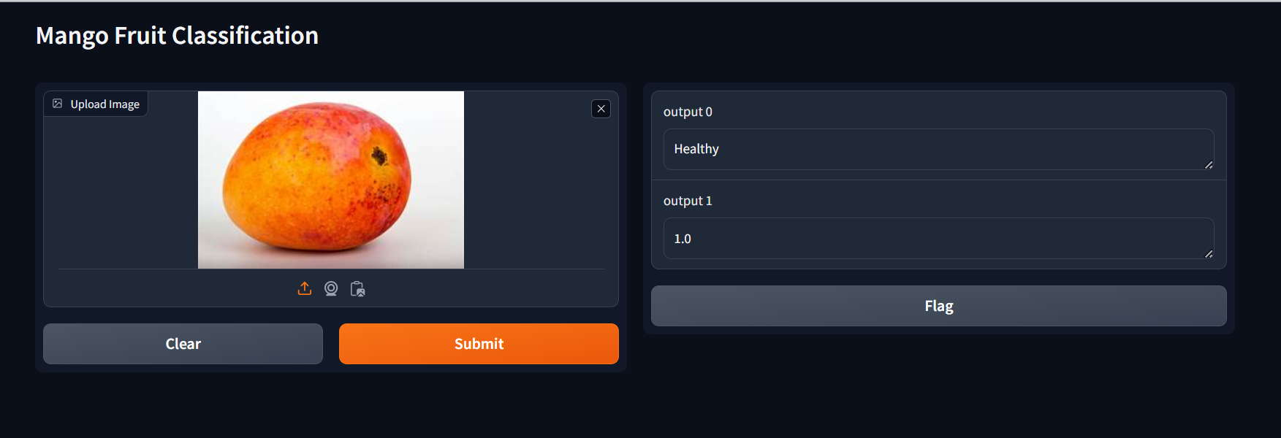
Results

Slide 12
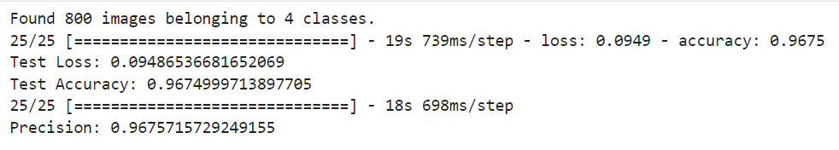
Results
Test Loss: 0.0949
Test Accuracy: 96.75%
Precision: 96.76%
UI: Gradio UI predicts mango fruit class and confidence score using uploaded image.

Slide 13
Conclusion
Conclusion:
CNN model achieves peak accuracy of 96% for mango fruit disease detection.
Offers farmers a valuable tool for early disease detection and improved crop management.
Streamlines disease detection processes, crucial for sustainable agriculture.

Slide 14
Future Scope
Expand dataset to enhance model robustness and accuracy.
Implement fully automated disease detection using drones in fields and factories.
Revolutionize mango cultivation by enhancing crop health monitoring and filtering processes.
Aim for optimal yield and quality through advanced technological interventions.

Slide 15
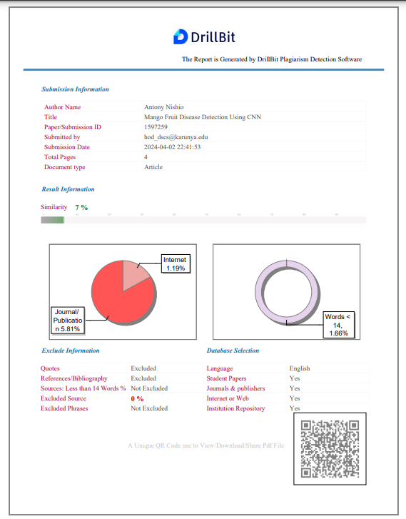
Outcome
Outcome Type : Paper Publication
Paper Title : Mango Fruit Disease Detection Using CNN
Authors : Antony Nishio J, Matthew Palmer Status : Plagiarism checked (7%)

Slide 16
Thank You

